Slide 1

Predictive Student Analysis

Slide 2


Analyzing the student’s academic performance, interests and feedback to predict their choice:
Post Graduation
Job
Drop-out

Slide 3

Proposed solution
Usage of Machine Learning algorithms to assess the candidate and to predict the most appropriate path to be chosen.

Slide 4
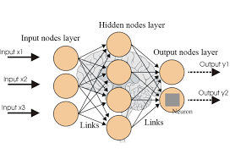
Implementation
Tools used:
TensorFlow: Open source framework to implement ML algorithms
Angular 5 : JS Component-based framework to build webpages
MySQL : Used as database
Flask : A Python microframework used as API

Slide 5
Complexities involved
Building a Machine Learning model incorporating student’s marks, student’s feedback and teacher’s feedback is challenging.
Since data is constantly increasing, constant training is required to get precise results. This is accomplished by usage of a Scheduler.

Slide 6

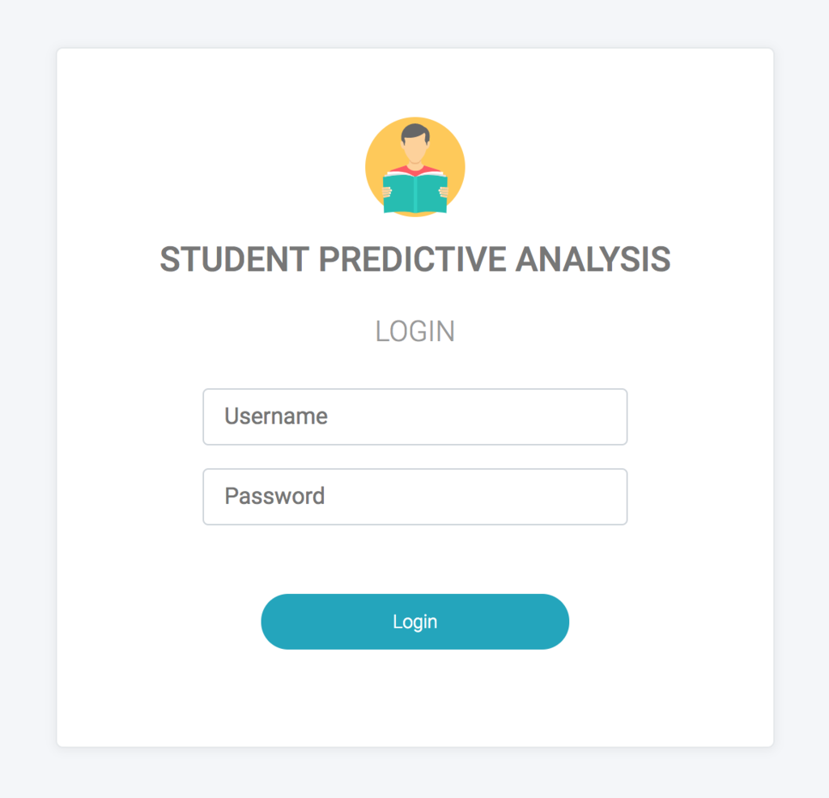



USE CASES Student:
Login
Analysis Report
Feedback
Academic Report

Slide 7

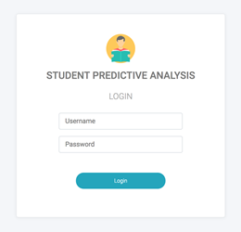

Teacher:
Login
Student profile
Teacher’s Feedback

Slide 8



Institution:
Login
Student’s Profile
Teacher’s Profile
Academic report
Drop-out rate

Slide 9

Outcomes:
Predicts the grade of the students based on previous semester grades.
Helps students who are indecisive, to choose a future course of action based on the feedback provided by student and teachers, either in:
  Job
  Desired Course in Post Graduation
Aids the registered colleges to find out students on the verge of a drop-out, provide remedial measures for the same.

Slide 10

Extension
Include method to check if all the users are registered, if not, suggest Sign Up page.
The current version predicts successive semester marks only in the range of the previous semester.
Non-participant Institutions can make use of the application after being invited.
Can be easily migrated to Cloud using AWS.

